Slide 1
GitHub Copilot
Lecturer: Ngo Huy Bien
Software Engineering Department
Faculty of Information Technology
VNUHCM - University of Science
Ho Chi Minh City, Vietnam
nhbien@fit.hcmus.edu.vn

Slide 2

Objectives

Slide 3

Contents
GitHub Copilot.

Slide 4

References
Nathan B. Crocker (2024). AI-Powered Developer - Build Great Software with ChatGPT and Copilot. Manning.

Slide 5
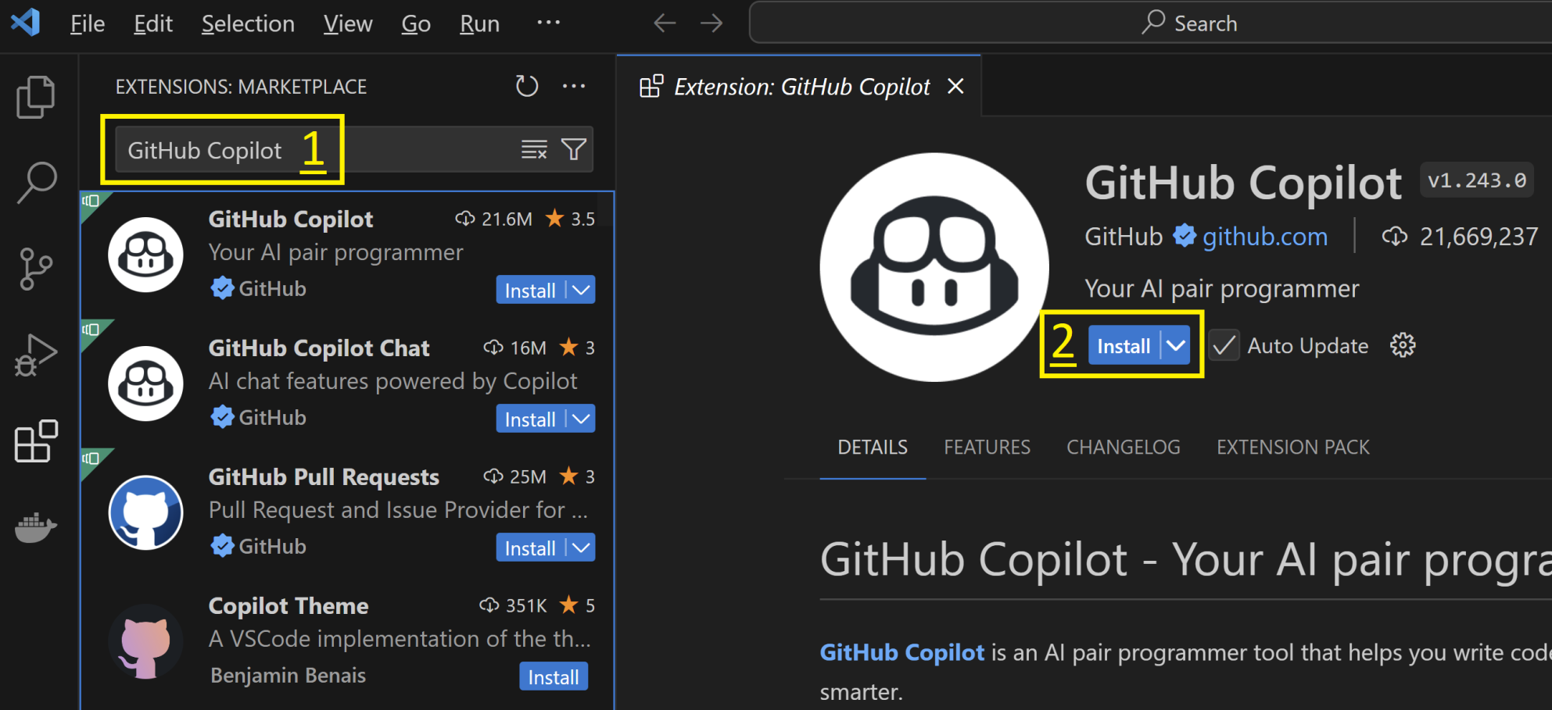
1. Install VS Code Extension

Slide 6
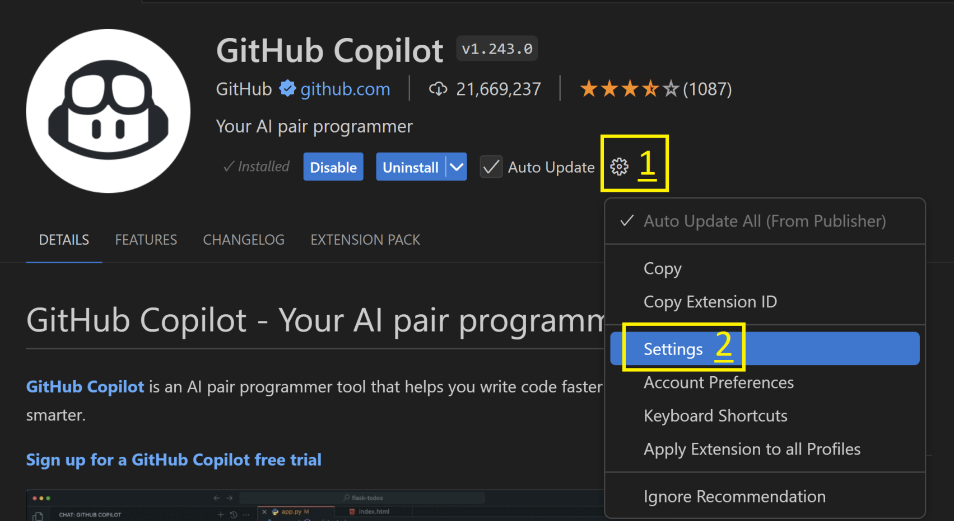
2. Open Settings

Slide 7
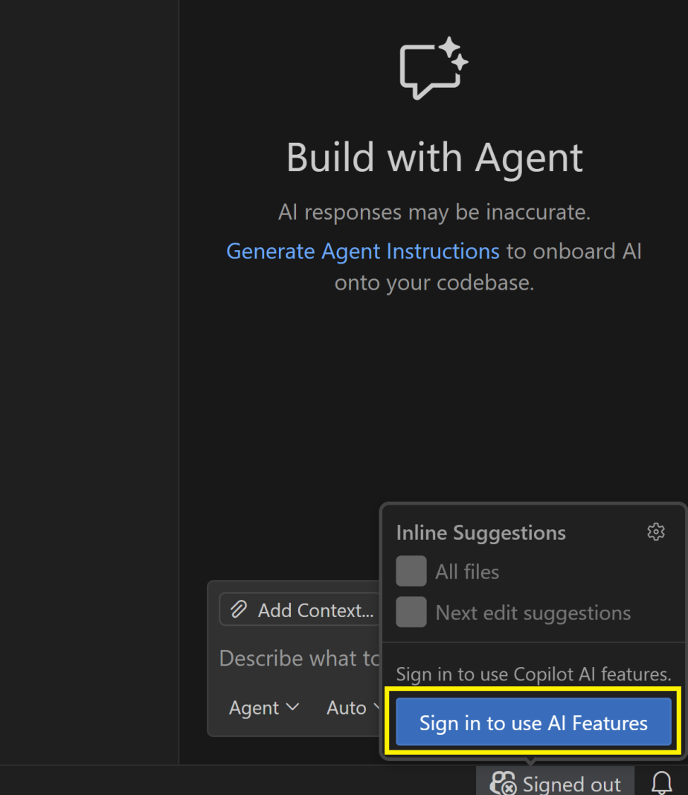
3. Sign in to GitHub

Slide 8
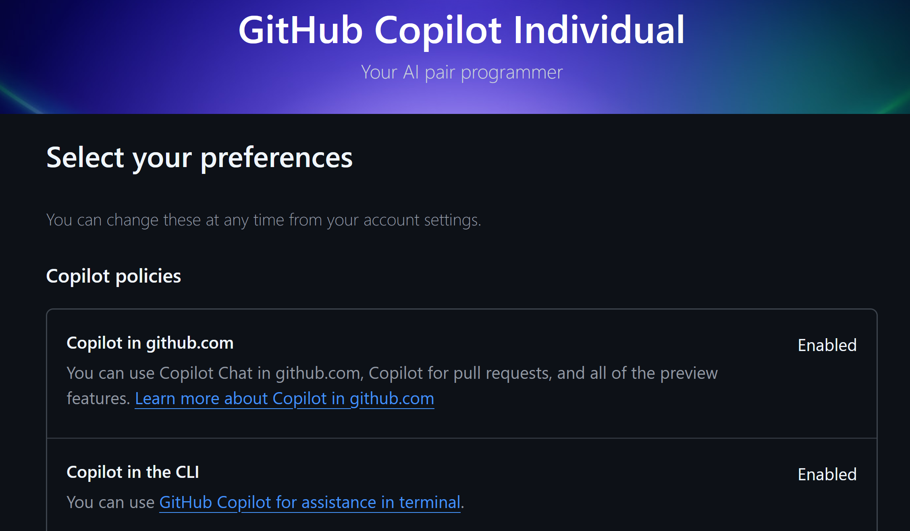
4. Select Preferences

Slide 9
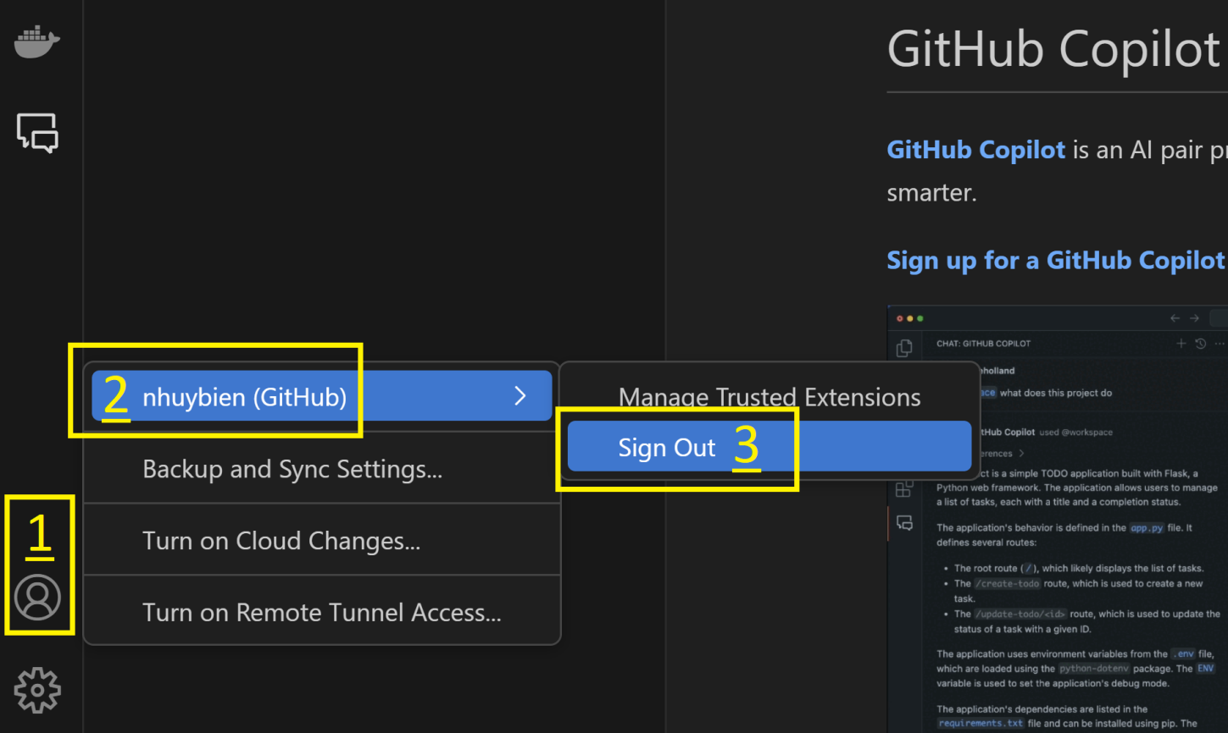
5. Sign out GitHub

Slide 10


Slide 11
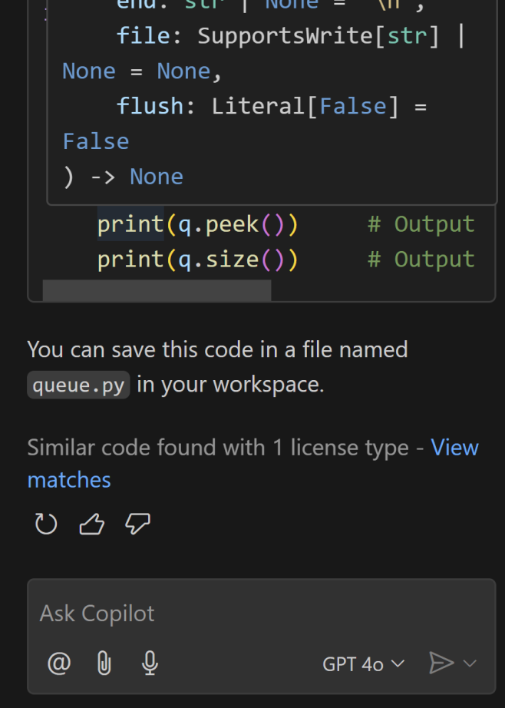
1. Create Code for a Queue
write a queue in python
copy the code to a .py file
save it to my current workspace

Slide 12
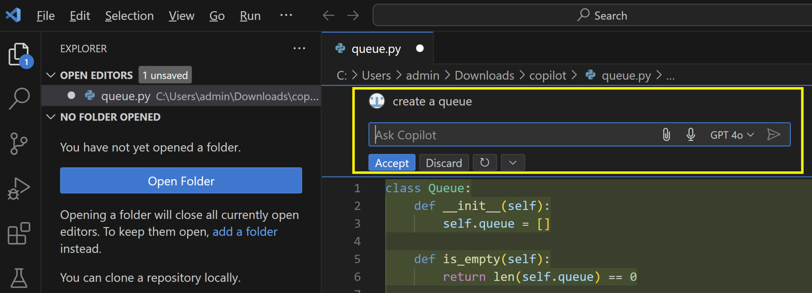
2. Use Inline Chat

Slide 13
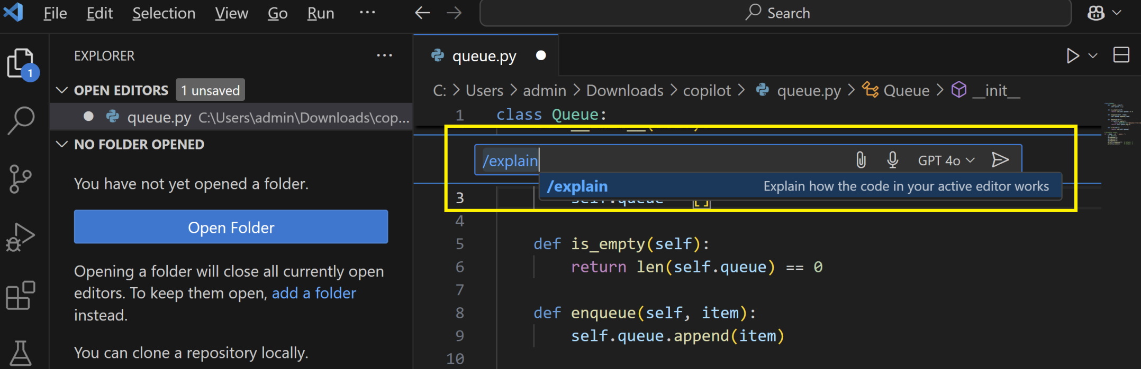
3. Explain Code

Slide 14
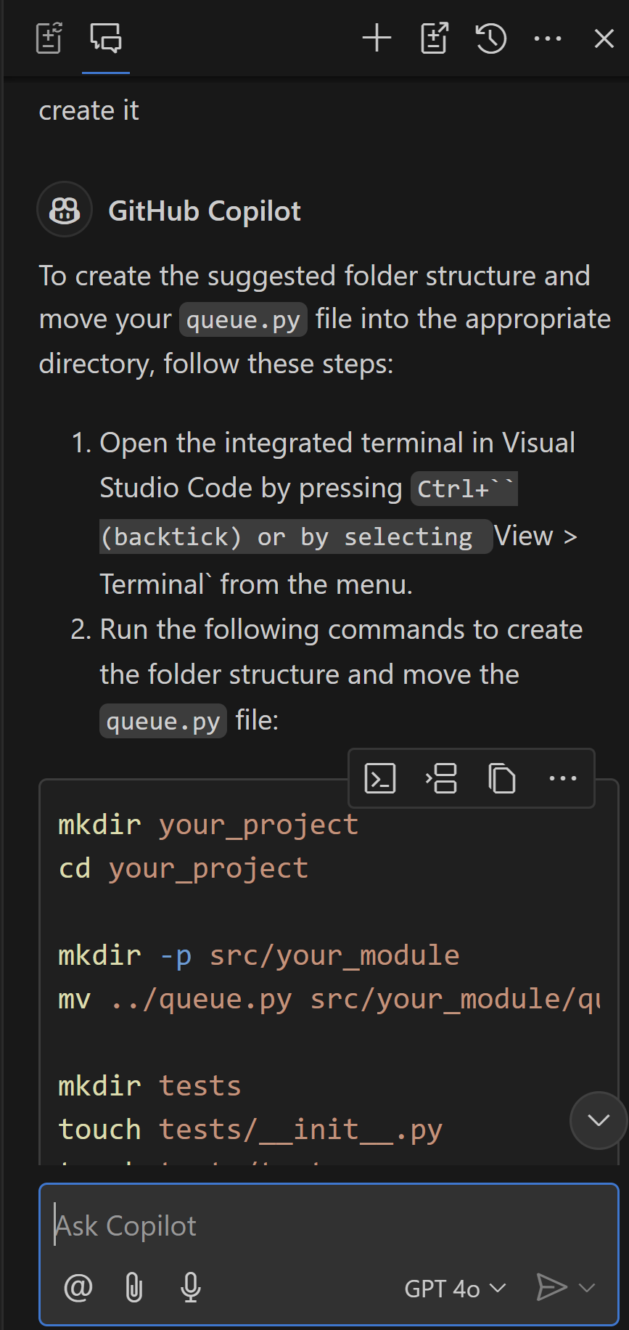
4. Suggest Folder Structure
what's my current folder structure
suggest a better folder structure
create it

Slide 15
5. Generate Code using Comments
# Python method using list to filter and return even numbers
Type def, press Tab, press Enter.
# Python method using a lambda function to filter and return even numbers
Type def, press Tab, press Enter.
# Python method with a for loop to filter and return even numbers
Type def, press Tab, press Enter.
# Python method to filter even numbers from a list, handle nonintenger values, and raise errors
Type def, press Tab, press Enter
# Assert statements
Type assert, press Tab, press Enter.

Slide 16
6. Apply Zero-shot Learning
# Python method using list to filter and return even numbers.
# Zero-shot learning: no examples of expected output are provided.
def filter_even_numbers_list(numbers):
pass
Delete "pass", press Tab, press Enter.

Slide 17
7. Apply One-shot Learning
# Python method using a lambda function to extract even numbers from a list.
# One-shot learning: one example of expected output is provided.
def filter_even_numbers_lambda(numbers):
"""example of expected output: filter_even_numbers_lambda([1, 2, 3, 4, 5, 6]) == [2, 4, 6]"""
pass
Delete "pass", type "return", press Tab, press Enter.

Slide 18
8. Apply Few-shot Learning
# Python method filter even numbers.
# Few-shot learning: a few examples of expected output are provided.
def filter_even_numbers(numbers):
"""examples of expected output:
filter_even_numbers([1, 2, 3, 4, 5, 6]) == [2, 4, 6]
filter_even_numbers([1, 2, 3, 4, 5, 6, 'a']) == ValueError
filter_even_numbers([1, 2, 3, 4, 5, 6, 7.0]) == ValueError
"""
pass
Delete "pass", press Tab, press Enter.

Slide 19
9. Improve Code using Constants
def calculate_shipping_cost():
# Get input for package weight and distance
weight = float(input('Enter package weight: '))
distance = float(input('Enter distance: '))
# Calculate cost based on weight and distance
if 0 <= weight < 2:
cost = distance * 1.5
elif 2 <= weight < 5:
cost = distance * 2.5
elif 5 <= weight < 10:
cost = distance * 3.5
elif weight >= 10:
cost = distance * 5
else:
print('Invalid weight')
return
if distance > 500:
cost += 50
print(f'The shipping cost is: {cost}')
calculate_shipping_cost()
# Select code, then type "Improve code readabilty"
# Select code, then type "Remove magic numbers"

Slide 21
1. Prepare flask App
from flask import Flask
app = Flask(__name__)
@app.route('/')
def index():
return 'Hello, World!'
if __name__ == '__main__':
app.run(debug=True)

Slide 22
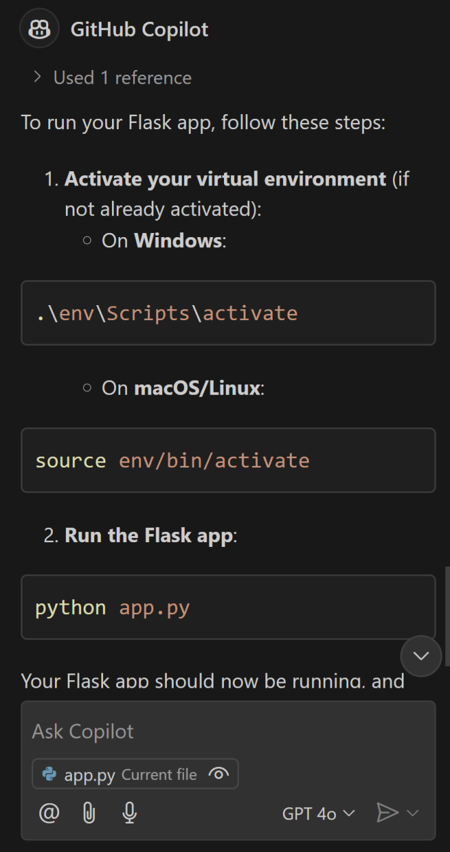
2. Run flask App
# how to activate env
python -m venv env
.\env\Scripts\activate
# how to install reqs
echo flask > requirements.txt
pip install -r requirements.txt
# how to run this app

Slide 23
3. Add Database and Model
# Connect to sqlite3 using SQLAlchemy
# Connect to the database
# Create a ToDo class
# Get all Todos
# Render to todo_list to a template
# Create the database with context

Slide 24
4. Create a Template
# Create a template for this return render_template('index.html', todo_list=todo_list) in app.py with title and complete columns
# Differentiate 2 complete statuses

Slide 25
5. Create Functionalities
# Create function to add a new todo
# Create route to add todo using the add_todo function
In template file: # create links for completing and deleting todo

Slide 27
Exploring Settings
Pay attention to code security issues.

Slide 29
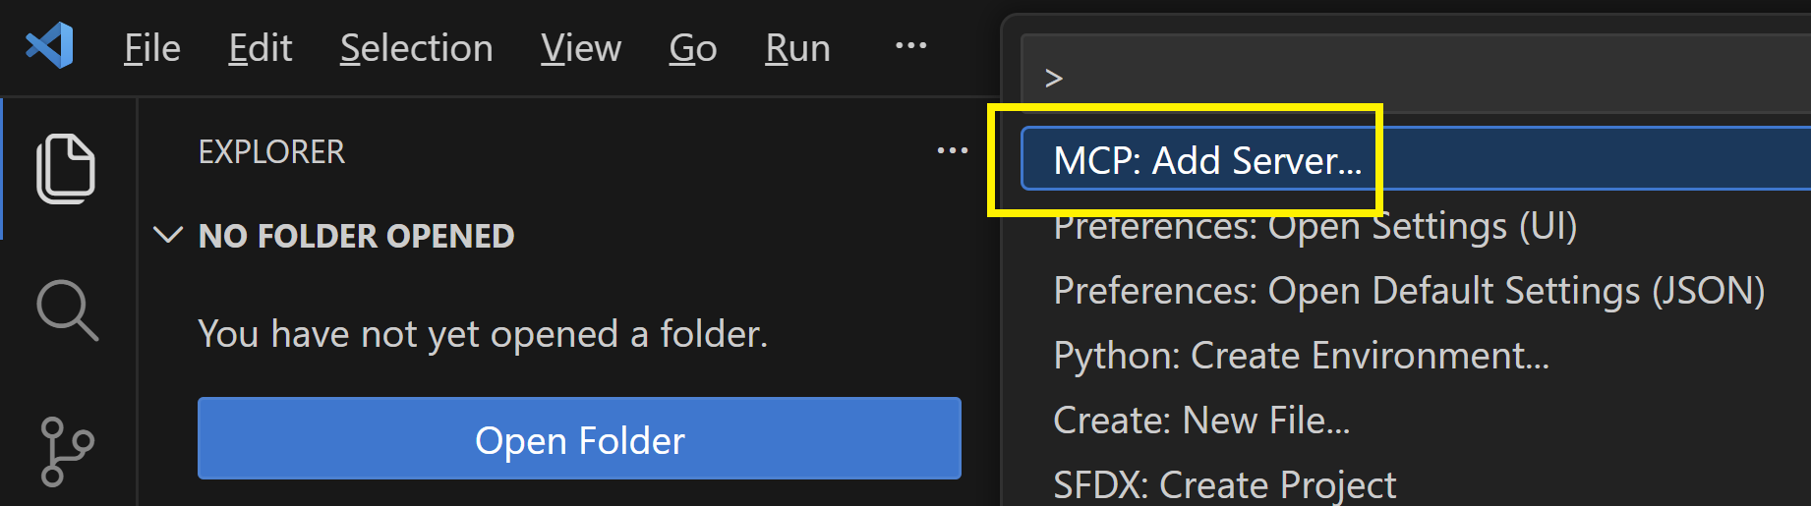
1. Add GitHub MCP Server
Connect AI assistants to GitHub - manage repos, issues, PRs, and workflows through natural language.
URL: https://api.githubcopilot.com/mcp/

Slide 30
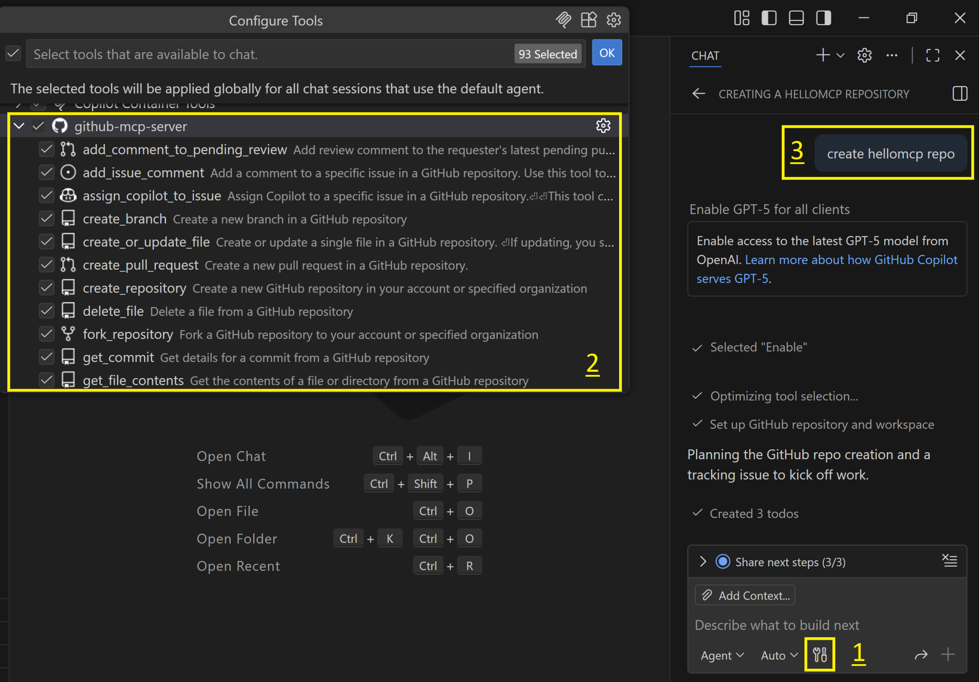
2. Review and Test GitHub Tools

Slide 32
Notes
Enterprise software development with the support of ChatGPT and Copilot: Project-based case study.
These two tools support quite well in refining Requirements, Architecture, Design and suggesting code segments for implementation, automatically generating unit tests and deployment scripts.
I have only tested them with Python, but the results are quite impressive, and have great potential to shorten the time for building simple projects or prototypes.
There are still many times when AI and developers do not understand each other (quite annoying 🙂 ).
In order to use the results that AI creates, the developer must have a background, understand architecture, have worked with libraries/tools, and be able to combine knowledge together.

Slide 33
A Benchmark
https://github.com/codebude/QRCoder
Add support for net481 in the QRCoder project.
Add support for net481 in the QRCoderDemo project.
Add support for net8.0 in the QRCoder project.
Add support for net8.0-windows in the QRCoderDemo project.
Add support for net481 in the QRCoder project.
Fix the failing QRCoderTests.PostscriptQRCodeRendererTests.
Which .NET targets are not installed on my machine?
Remove all .NET targets not installed on my machine from the solution while ensuring the build remains successful.

Slide 34

Thank You & See You Again

